Slide 1
Robot Learning
Author: Batyrlan Nurbekov
Advisor: Michael Gennert

Slide 2
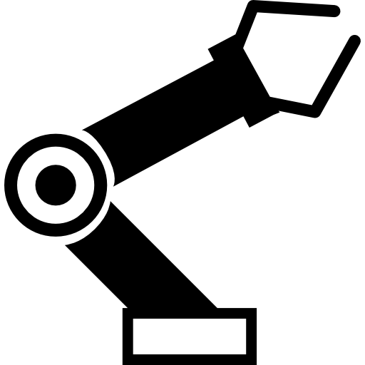
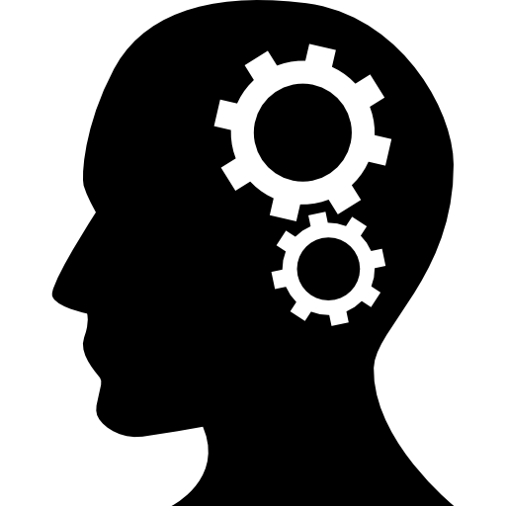

Goals
Create an adaptive walking gait on Atlas Humanoid Robot.
Mimic human’s learning and motion mechanisms.
Reduce state space of the problem at hand.

Slide 3
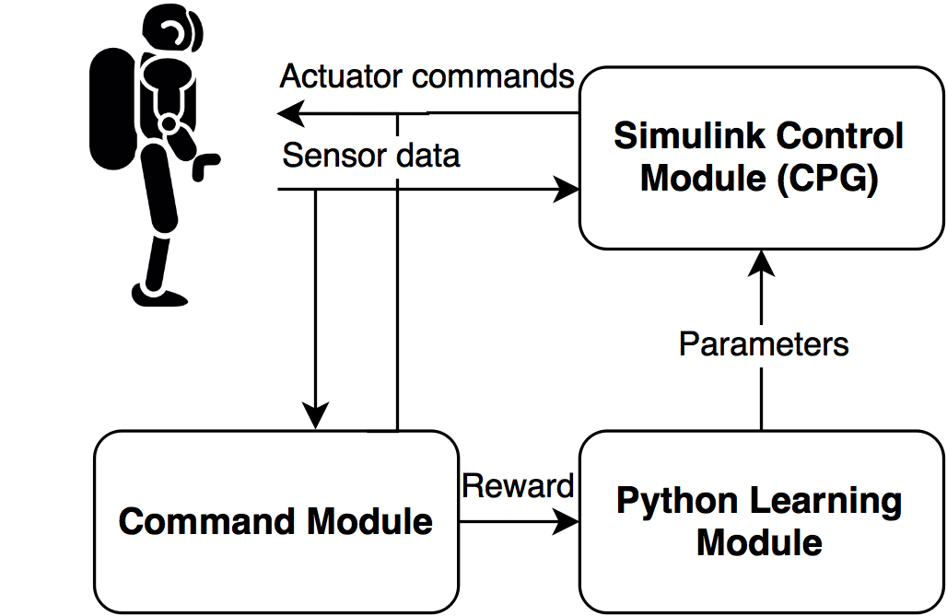
System Overview

Slide 4
Approach
Approach steps:
Implement learning modules in Python; control module (CPG) in MATLAB Simulink.
Use ROS for communications between modules.
Use Gazebo simulator for training.
Put the set of learnt parameters in the simulation to the robot.

Slide 5
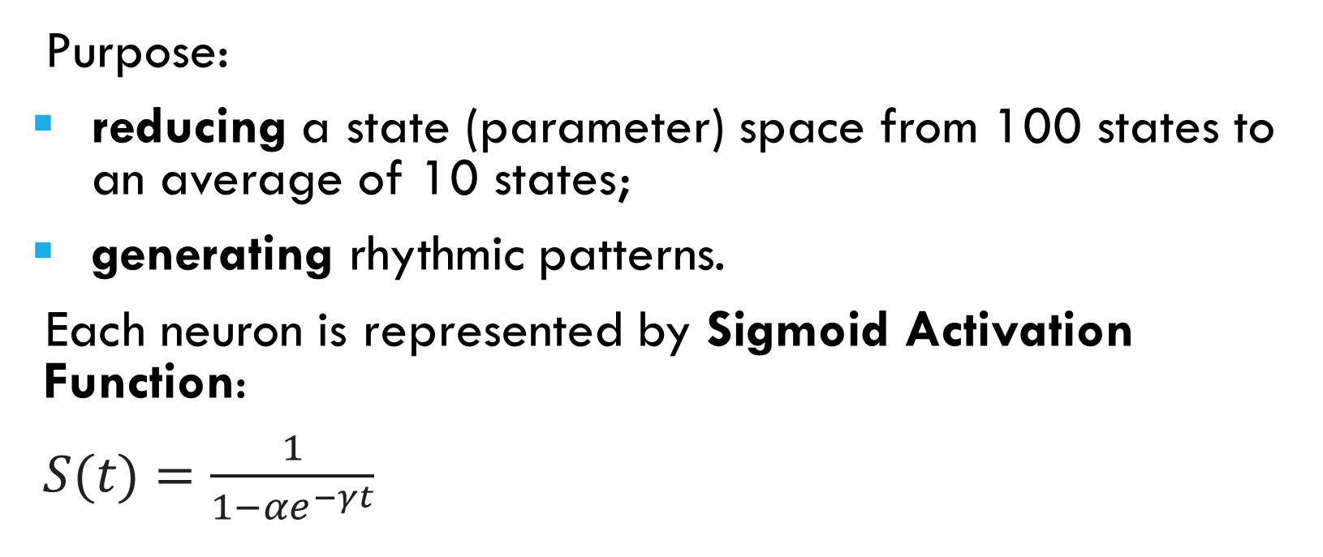
Central Pattern Generator
Purpose:
reducing a state (parameter) space from 100 states to an average of 10 states;
generating rhythmic patterns.
Each neuron is represented by Sigmoid Activation Function:
$S(t)=\frac{1}{1−{αe}^{−γt}}$

Slide 6
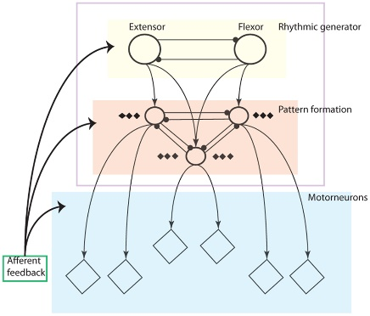
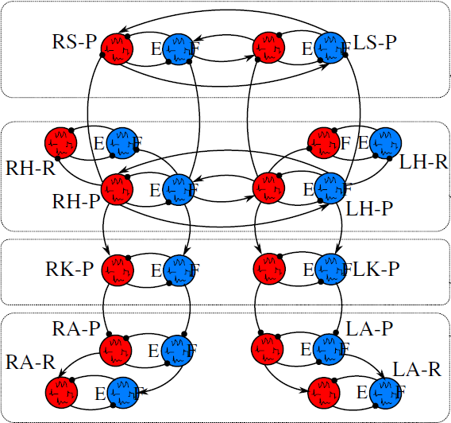
Central Pattern Generator
Layers of CPG
RG Layer

Slide 7
Central Pattern Generator

Slide 8
Learning
Parameters for CPG are learnt by
CMA-ES (learning);
Kohonen self-organizing maps (memory) → Success, Failure Map.

Slide 9
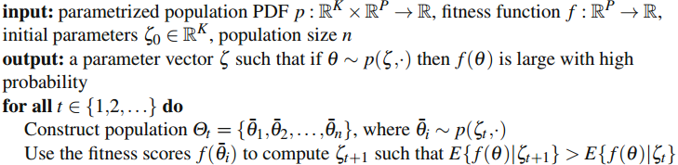
Covariance Matrix Adaptation - ES
Purpose:
learning a set of parameters for CPG that lead to stable walking gate initially.

Slide 10
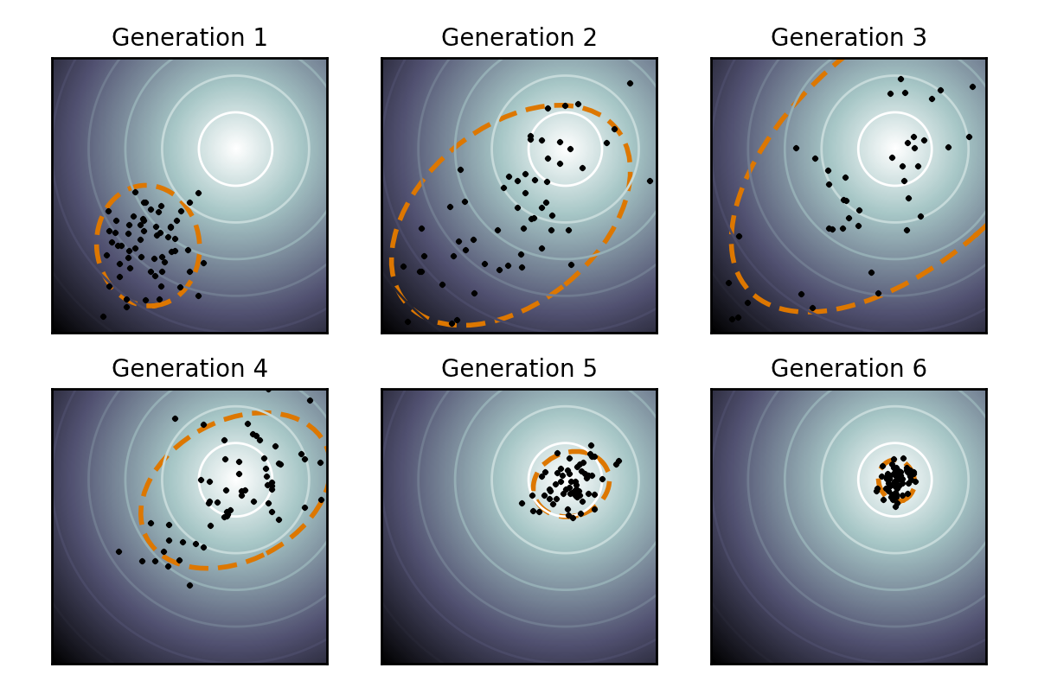
Covariance Matrix Adaptation - ES

Slide 11
Qualitative Adaptive Reward Learning
Purpose:
memorizing a particular region in parameter (state) space that leads to success/failure;
finding global optimal set of parameters in success region after failure region is learnt.

Slide 12
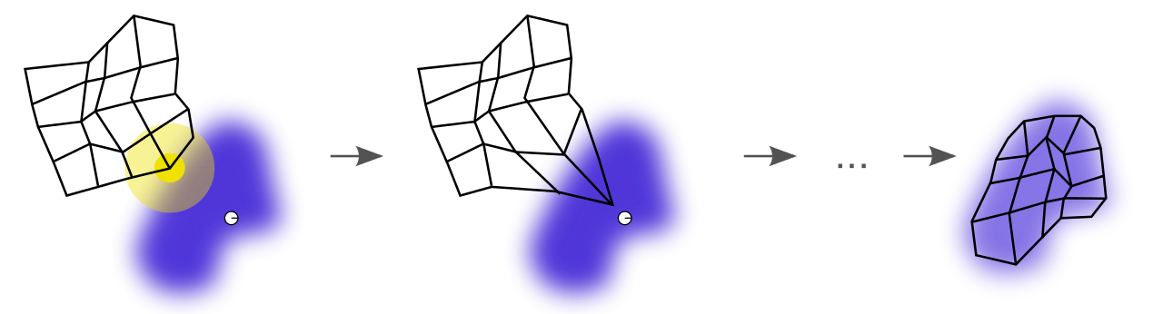
Qualitative Adaptive Reward Learning

Slide 13
RESults
Robot successfully making two-three steps in simulation.
Reward over 700 trials:

Slide 14
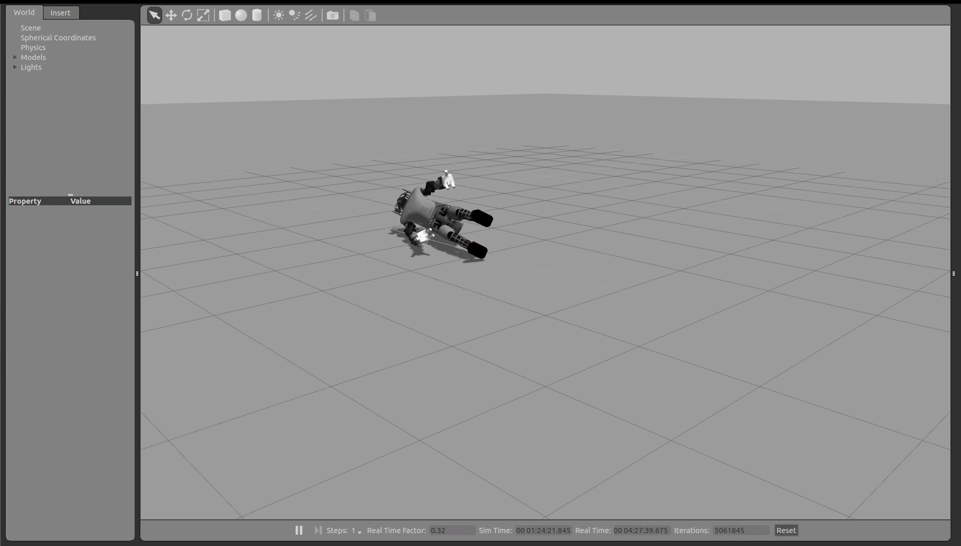
Simulation

Slide 15
Conclusions + future work
Conclusions
Future work
A method for learning a biologically plausible walking gait has been presented.
An approach of dimensionality reduction for the problem has been shown.
Generalization of the learnt experience to environmental changes.
Automatic CPG controller structure construction → allow for other motor tasks.
Balancing module that could learn online and make adjustments to the robot’s posture in real-time (NeoRL and CACLA).

Slide 16
Thank you!

Slide 17
References
Nassour, John. "Success-Failure Learning for Humanoid: study on bipedal walking." PhD Thesis. 2013.
Li, Cai, Robert Lowe and Tom Ziemke. "Humanoids learning to walk: a natural CPG-actor-critic architecture." n.d.
Wiering, Marco and Martijn van Otterlo. Reinforcement Learning: State-of-the-Art. Springer, 2011.
Stowell, Dan. Somtraining.

